Slide 1
Contents
What is an individual project?
What academic support are you given?
How did you decide on a project?
What is your project about?
What do you hope to achieve by the end?
Are there particular modules that have fed into your project?
How is it currently progressing?
What challenges are you facing?
What do you have to produce by the end?
If successful what impact could your project have?

Slide 2
Individual Project
UCAS Day Presentation
Notes:
Independent project which runs for the whole of your final year.
choose a topic to research and develop
Work with an academic to explore the cutting edge of this area of CS
Mandatory deliverables are a report and a presentation.

Slide 3

Why do a project?
Demonstrate a wide range of skills:
Technical & Research
Organisation & Self-Discipline
Work at the cutting edge of CS
Notes:
Other than because you have to
EXTENDED PIECE OF WORK

Slide 4
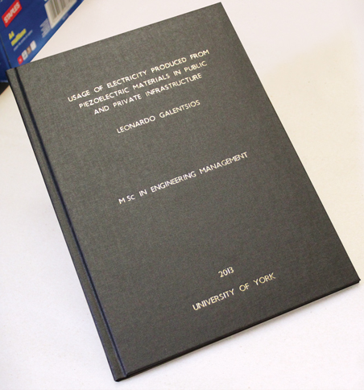
Timeline
Mid June - Project Allocation
October - Official Project Start
January - Presentation Practices
April - Project Deadline/Presentations
May - RESULTS!
Notes:
Project Allocation:
Pick from a list or suggest your own, but you need to find a supervisor to take it on.
Project supervisor becomes your pastoral supervisor.
Starts:
PCSW- taught module, helping with the transition to independent research and writing.
Throughout the year your supervisor is there to guide you.
Project Deadline:
At the end of the year.. You have a report to write, currently about 35-45 pages, hand in at the end of the year.
Presentation:
Given to one academic and a video camera. Generally watched by the marker before they read your project so it’s a good chance to give an general overview of the project details.

Slide 5
Parallel Programming Tools for Exploring Immune System Development
Notes:
Does anyone know what parallel programming is?

Slide 6
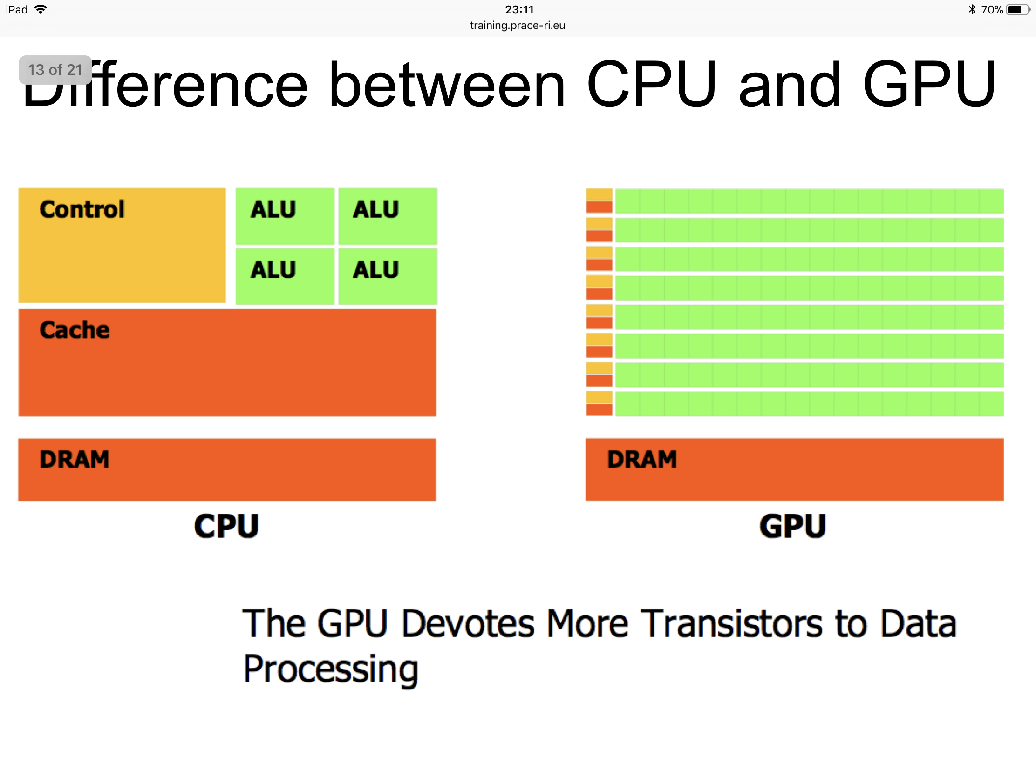
Program Parallelisation
CPU
GPU
4+ Cores
2500+ Cores
Notes:
Central Processing Unit
Graphic Processing Unit
CPU can handle different tasks at once
GPU can go through sheer quantity of numbers, particularly in matrix form, performing the same operation

Slide 7
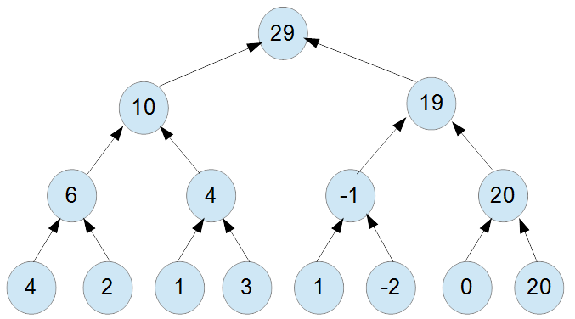
Program Parallelisation
Requires new algorithms for even the most basic operations
Addition of 5000 numbers:
Sequential: 4999 ops
Quad-Core CPU:
1668 ops
5000 Core GPU:
log₂(5000) = 12 ops
Notes:
Central Processing Unit
Graphic Processing Unit
CPU can handle different tasks at once
GPU can go through sheer quantity of numbers, particularly in matrix form, performing the same operation
400% speed up

Slide 8
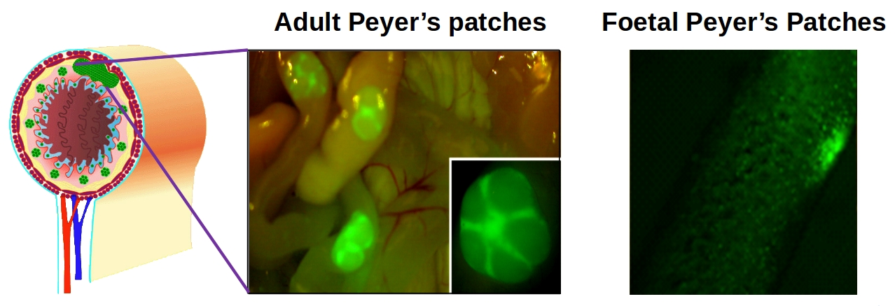
What is it about?
PPSIM
Agent Based Modelling
Motivation/Reasons
Notes:
PPSim is an existing simulation that was created to explore the development of clusters of lymphoid cells in the gut.
Aim to make it run faster using parallelism
… 3 months to run
Down to 5.4 hours
In depth programming project

Slide 9
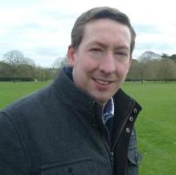
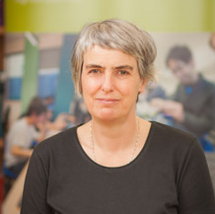
Kieran Alden
Fiona polack
Electronics @ York
CS @ Keele
Notes:
Everyone gets an Academic Supervisor who has a strong interest in the area of CS that relates to your project.

Slide 10
Current Work
Research into Existing Work
Previous York Projects
YCIL Papers
FLAME GPU
Exploring Hardware /
Notes:
Early stages, it’s only November!
Research into existing work..
Cutting Edge-

Slide 11

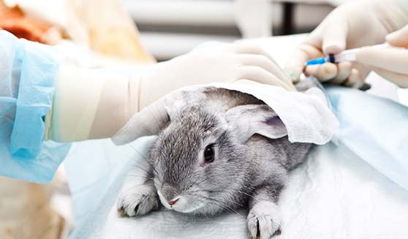
Project Impact
Generally
$2.5bn R&D cost per drug
Reduction in Animal Testing
PPSIM so far
New knowledge of the immune system
Worked with labs to prove this in Vitro
Notes:
Obviously there’s a lot of scope within biology for simulations to help with testing.
So far it’s been used to gain a greater understanding of Peyer’s Patch formation.
Further understanding means we could trigger a faster immune response to pathogens
Impact of work has gone to three pharmaceutical firms and one cosmetic firm

Slide 12
Any Questions?

